Slide 1



ecx.io Frontend Bootcamp — Accessibility in HTML 02.08.2021.

Slide 2

Agenda
Custom combobox
[lunch break]
Accessibility testing

Slide 3


Custom combobox

Slide 4
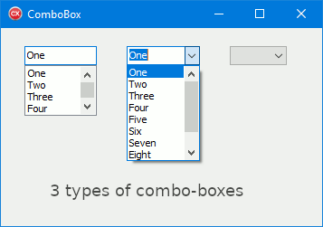
Custom combobox
Commonly used graphical user interface widget.
Combination of a dropdown list/listbox and a single-line editable textbox, allowing the user to either type in a value, or select it from the list.
W3C definition of combobox.
Source: http://www.festra.com/cb/tip-combobox.htm

Slide 5
Custom combobox - notes
When the listbox popup is displayed, it contains suggested values that complete or logically correspond to the characters typed in the textbox.
Users may set the value of the combobox by choosing a value from the list of suggested values.

Slide 6
Custom combobox - requirements
- element with role combobox must contain a text input element with role textbox that has the aria-multiline set to false
- if a combobox provides autocompletion, the textbox element must have aria-autocomplete to the value that describes the behavior
- default state of a combobox is collapsed, and therefore initially the combobox has to have aria-expanded set to false. When it is expanded, this value have to be true.
- textbox must set the aria-controls attribute that refers to the combobox popup/list element, which will be dynamically displayed
- combobox must have the value for aria-haspopup attribute with the type of the popup (listbox)
- combobox must have the value for aria-owns attribute with the ID of the listbox, to indicate the relationship between DOM elements
- keyboard mechanism should be implemented to move the focus between textbox element and the listbox. - e.g. Down Arrow should move the focus from the text input to the first focusable list item
- when option is selected in the listbox, with aria-activedescendant on textbox element, we can refer to the selected item

Slide 7
Custom combobox exercise

Slide 8
Markup

Slide 9
A11y testing

Slide 10
A11y testing
Huge number of tools to help us in verification of the a11y conformtance.
List of a11y evaluation tools on w3.org.

Slide 11
A11y Project
www.a11yproject.com
Community-driven effort to make digital a11y easier.
Contains various groups of content like books, blog posts, online tools, etc.
Checklist, based on WCAG – easy-to-use steps of what we have to do to fulfill certain criteria.
www.a11yproject.com/checklist

Slide 12
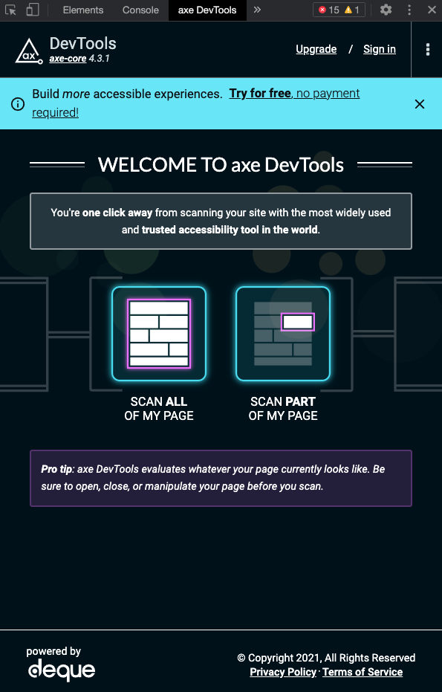
aXe
A11y engine for automated testing of HTML based user interfaces.
Checks the HTML for potential a11y problems and reports them.
aXe project
aXe chrome extension

Slide 13
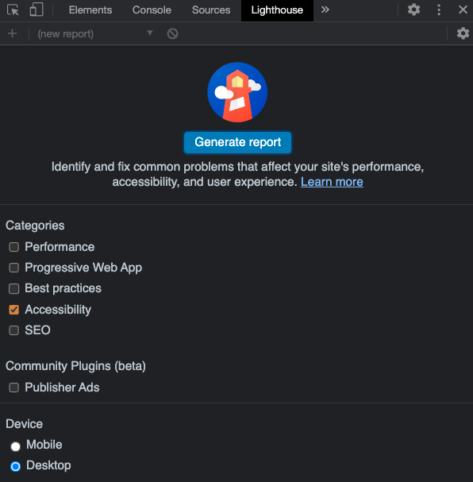
Lighthouse
Open-source, automated tool for improving performance, quality and correctness of your web pages.
Besides a11y, it can check multiple different categories like performance, SEO or best practices.

Slide 14
IBM Equal Access Accessibility Checker
Chrome extension that adds automated accessibility checking capabilities to Chrome
Part of the IBM Equal Access Toolkit – toolkit which increases the a11y of your project, with in different phases of the project.
https://github.com/IBMa/equal-access

Slide 15

References
https://www.w3.org/TR/wai-aria-1.1/#combobox
https://www.w3.org/TR/wai-aria-practices-1.1/examples/combobox/aria1.1pattern/listbox-combo.html
https://www.a11yproject.com

